Slide 1

Real-Time Pedestrian Detection in Autonomous Systems using Deep Learning
by
Neeraj G
Roll No. 224G1A3362
Aliya S
Roll No. 224G1A3303
Harshith Raj P
Roll No. 224G1A3327
Om Pradeep P
Roll No. 224G1A3365
Under the guidance of
Mr. A. Kiran Kumar _{M. Tech., ( Ph. D).}
Assistant Professor
Department of Computer Science and Engineering (AI & ML)
Srinivasa Ramanujan Institute of Technology
(Affiliated to JNTUA & Approved by AICTE) (Accredited by NAAC with ‘A’ Grade & Accredited by NBA (EEE, ECE & CSE)
Rotarypuram Village, B K Samudram Mandal, Ananthapuramu – 515701.
2025 - 2026
Dept. of Computer Science and Engineering (AI&ML)
Srinivasa Ramanujan Institute of Technology

Slide 2
Contents
Abstract
Problem Statement
Objectives of Project
Literature Survey
Existing Systems
Proposed Work-(Methods to be followed for proposed system)
Architecture, UML diagrams, data flow
Implementation
Results & Analysis
References
GitHub Link

Slide 3
Abstract
The general topic of this study is pedestrian detection in autonomous systems, with the specific research problem focusing on the limitations of current deep learning frameworks, particularly YOLOv8, in handling partially occluded, small-scale, and densely clustered pedestrians. The main objective of the research is to design improved architectures that enhance detection robustness while maintaining real-time performance, thereby advancing safe navigation and collision avoidance in complex urban environments. To achieve these goals, we introduce four enhanced models collectively termed YOLOv9, which incorporate adaptive attention mechanisms, multi-scale feature fusion, and temporal context modeling. The methods employed involve extensive benchmarking across standard pedestrian datasets, with performance evaluated using precision, recall, and mean average precision (mAP) as key metrics. The results demonstrate that YOLOv9 significantly outperforms YOLOv8, achieving higher precision and recall, particularly in challenging scenarios characterized by occlusion, scale variation, and dense crowding, while preserving the speed advantages of the YOLO framework. In conclusion, the findings underscore the importance of architectural innovation in pedestrian detection, highlight the effectiveness of attention-driven and multi-scale approaches, and suggest that YOLOv9 provides a more robust solution for autonomous navigation systems, laying the groundwork for future advancements in adaptive deep learning models.

Slide 4
Problem Statement
Pedestrian detection is a crucial task in autonomous systems, directly impacting the safety and reliability of navigation in dynamic environments. Existing deep learning models like YOLOv8 offer notable performance but still struggle with challenges such as occluded pedestrians, varying scales, low-light conditions, and dense crowd scenarios. These limitations reduce detection accuracy and may lead to critical failures in real-world autonomous applications. There is a need for more advanced models that can effectively handle complex scenarios while maintaining high precision and robustness. This project addresses these challenges by proposing improved YOLO variant—YOLOv9—with enhanced detection capabilities.

Slide 5
Objectives of Project
• The rapid growth of autonomous systems, especially in transportation and surveillance, requires highly accurate and robust pedestrian detection to ensure public safety and prevent accidents.
• Existing models such as YOLOv8 have shown significant progress in real-time object detection.
• However, YOLOv8 faces limitations in detecting pedestrians under occlusion, varying scales, and complex backgrounds, highlighting the need for improvement.
• This challenge motivated the design of enhanced deep learning models capable of overcoming these detection issues.
• We introduce YOLOv9 incorporating architectural advancements to improve detection robustness.
• The goal is to contribute to the development of more reliable pedestrian detection systems that can support real-world deployment in autonomous environments.

Slide 6
Literature survey
No | Title | Author | Journal Name & Year | Methodology Adapted | Key Findings | Gaps
1. 2. 3. | A Survey of Deep Learning Approches for Pedestrian Detection in Autonomous Systems Object Detection Learning Techniques for Autonomous Vehicle Applications One-Stage Pedestrian Detection Using ResNet + SSD | Majdi Sukkar, Rajendrasinh Jadeja, Madhu Shukla Mehdi Masmoudi et al. Wang et al. | IEEE Acess Journal & 2024 IEEE ICVES, 2019 IEEE Explore, 2019 | Deep Learning Techniques SVM, YOLO, SSD ResNet + SSD | Enchanced Detection Frameworks, Real Time Processing, Research Directions YOLO is fast but struggles with small objects; SSD better for multi-scale detection Multi-scale feature maps, real-time detection, improved occlusion handling | Exploring these models on a diverse datasets which has low-visibility conditions, shadows, occlusions etc., YOLO limitations in occlusion and small-scale detection; SVM unsuitable for real-time Still challenged by dense crowds and small pedestrians

Slide 7
Existing System
Relies mainly on deep learning models like YOLOv8.
• Provides improved accuracy and faster detection compared to earlier versions.
• Uses anchor-free mechanisms and enhanced feature extraction for general object detection.
• Limitations: struggles with occlusion, low resolution, cluttered backgrounds, and scale/pose variations.
• Lacks adaptability to motion context and temporal consistency, reducing robustnesss in autonomous driving and surveillance.
Confuses pedestrians with similar background elements.
Limited adaptability in dense, dynamic environments.

Slide 8
Proposed Work
Introduction of YOLOv9:
Cross-attention for occlusion.
Multi-scale fusion for size variation.
Hybrid enhancements for real-time deployment.
- Training on benchmark datasets with advanced augmentation.
Implementation
Data Collection: Caltech, CityPersons, CrowdHuman.
Preprocessing: Normalization, augmentation (spatial + photometric).
Training: AdamW optimizer, CIoU loss, mixed precision.
Evaluation: mAP@0.5, precision/recall, FPS.
Deployment: Vercel interface, PyTorch models.

Slide 9
Requirements (functional and non-functional)
Functional Requirements
Upload images
Detect pedestrians
Return bounding boxes & confidence
Non-Functional Requirements
Real-time performance
High accuracy under occlusion
Scalability & reliability

Slide 10
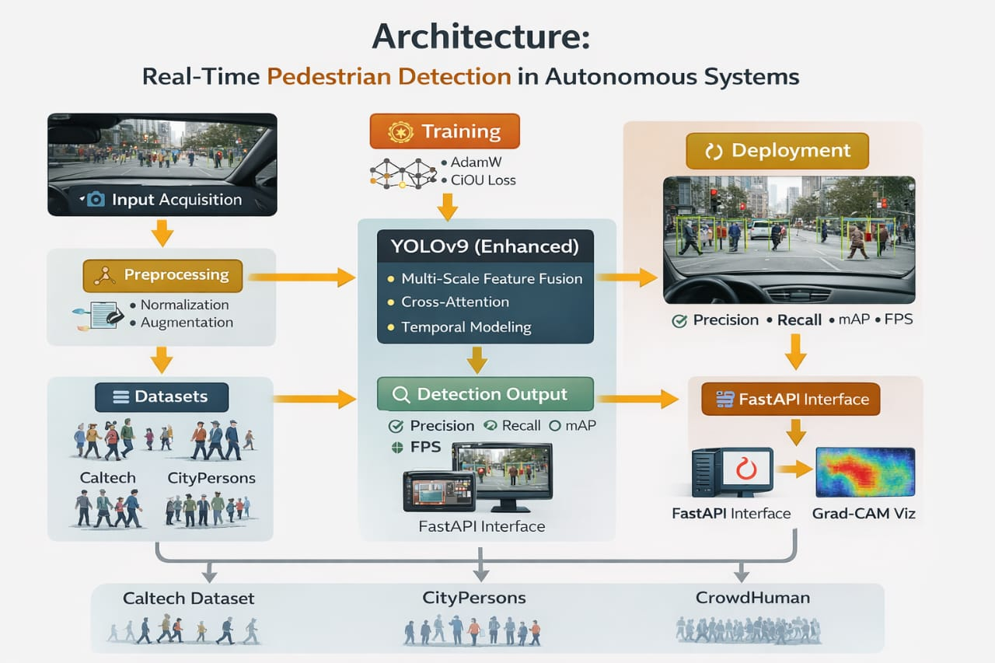
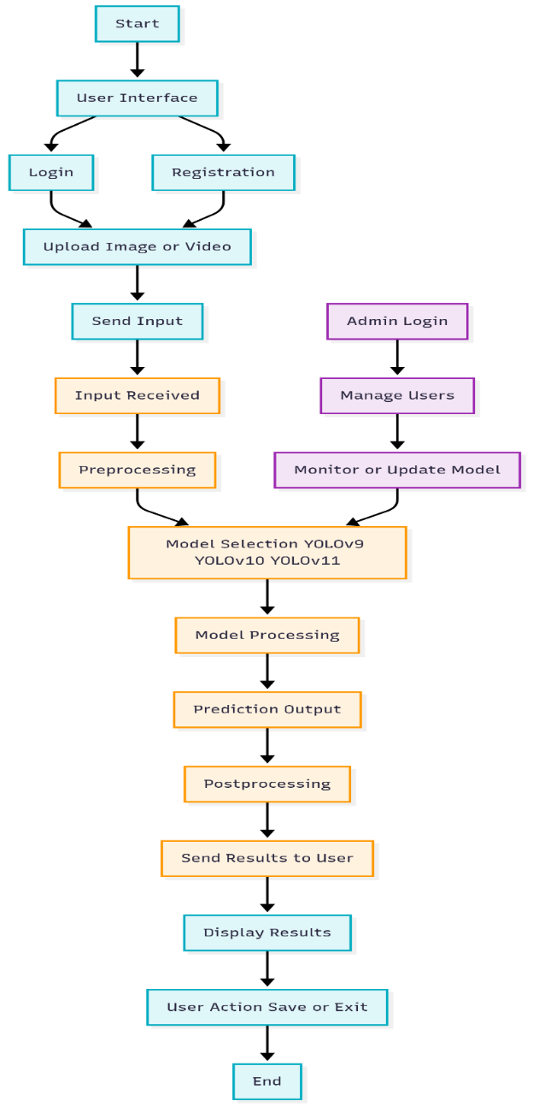
Architecture

Slide 11
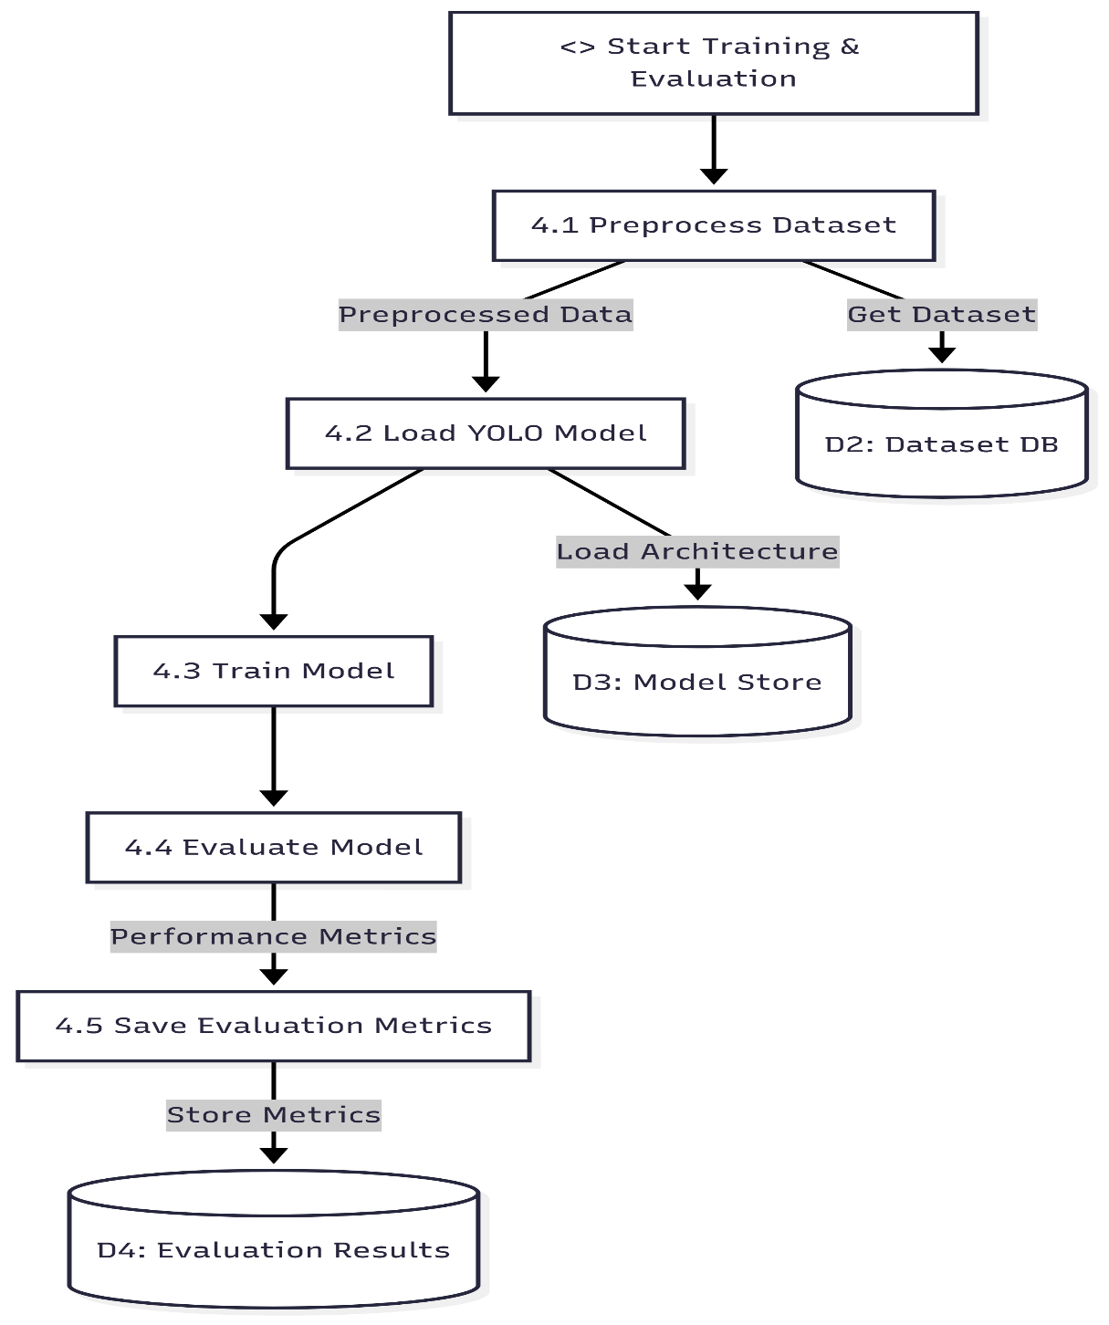
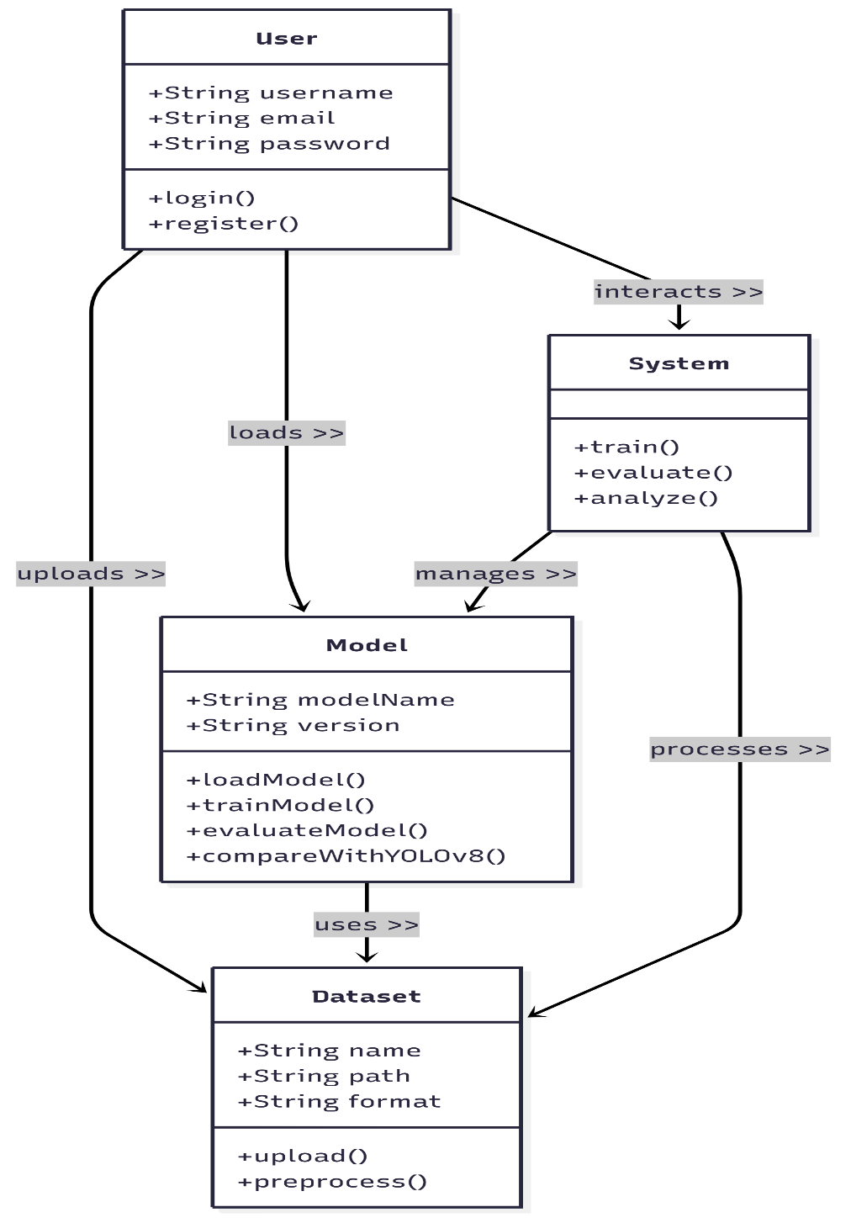
UML Diagrams

Slide 12


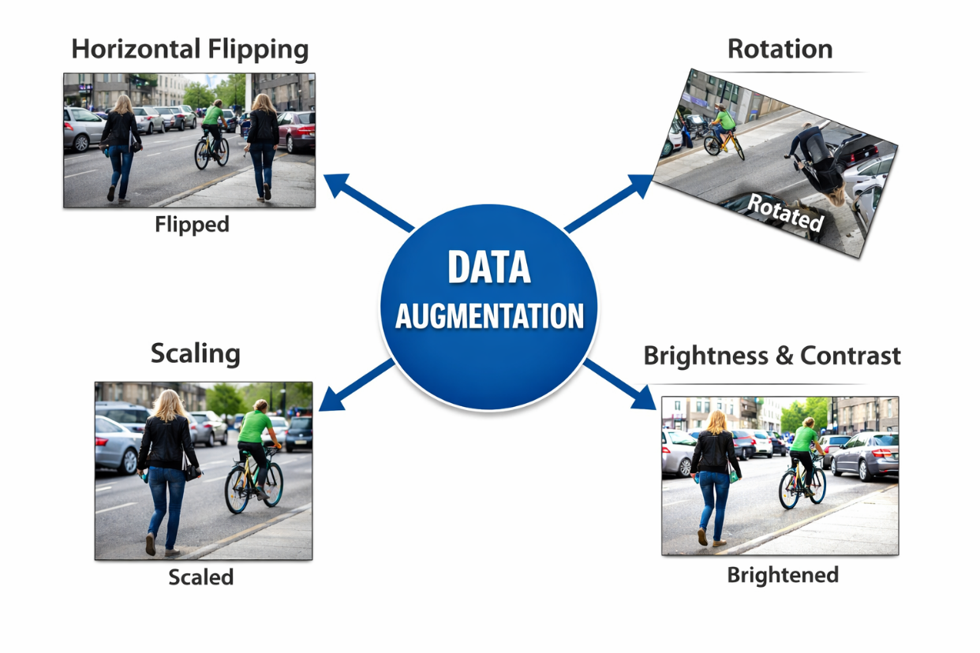
Implementation
Dataset Collection:
KITTI Dataset – Road scene images
CityPersons Dataset – Urban pedestrian images
CrowdHuman Dataset – Dense crowd images
Data Preprocessing:
Image Resizing: All images resized to 640 × 640
Normalization: Pixel values scaled to [0,1]
Data Augmentation:
Horizontal flipping
Rotation
Scaling
Brightness and contrast adjustment

Slide 13
Conti..
Model Development
The system uses a YOLO-based object detection model designed for fast and accurate detection.
Model Structure:
• Backbone: Extracts image features
• Neck: Combines features from multiple scales
• Head: Predicts bounding boxes and confidence scores
Model Training
The model is trained using labeled image datasets.
Training Configuration:
• Optimizer: AdamW
• Learning Rate: 0.001
• Batch Size: 32
• Epochs: 300
• Loss Function:
CIoU (bounding box loss)
Training is performed on GPU-enabled systems for efficiency.

Slide 14
Conti..
Model Evaluation
The trained model is evaluated using standard metrics:
• mAP@0.5: Measures detection accuracy
• Precision: Correct detections
• Recall: Detection coverage
Output Generation + Site Creation
The output consists of:
• Bounding boxes around detected pedestrians
• Confidence scores
• Annotated output image

Slide 15
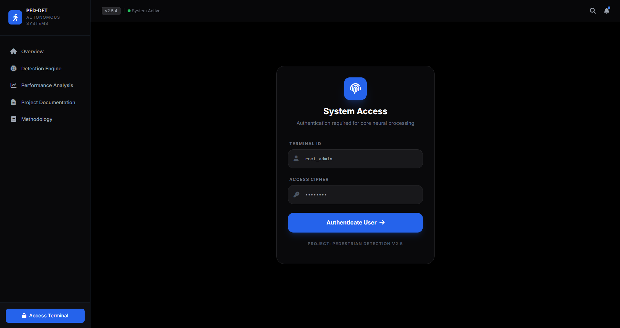
Conti..
Fig: Login Page

Slide 16
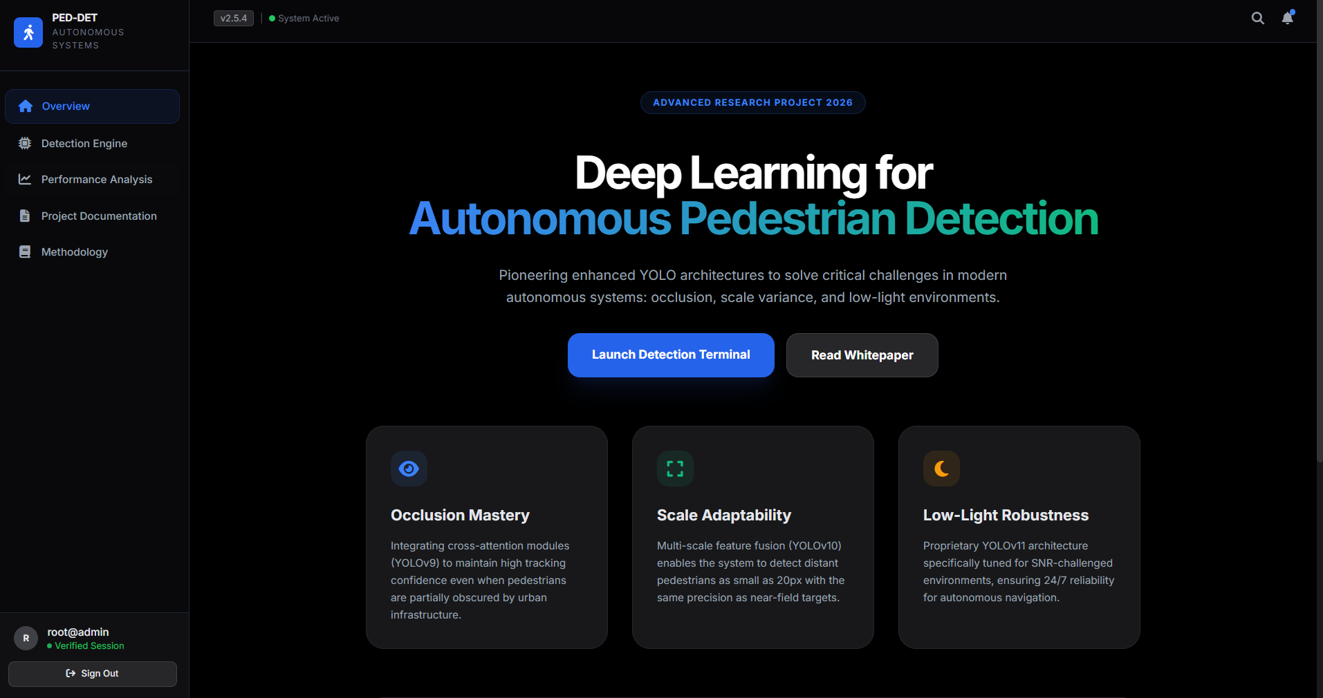
Conti..
Fig: Landing Page

Slide 17
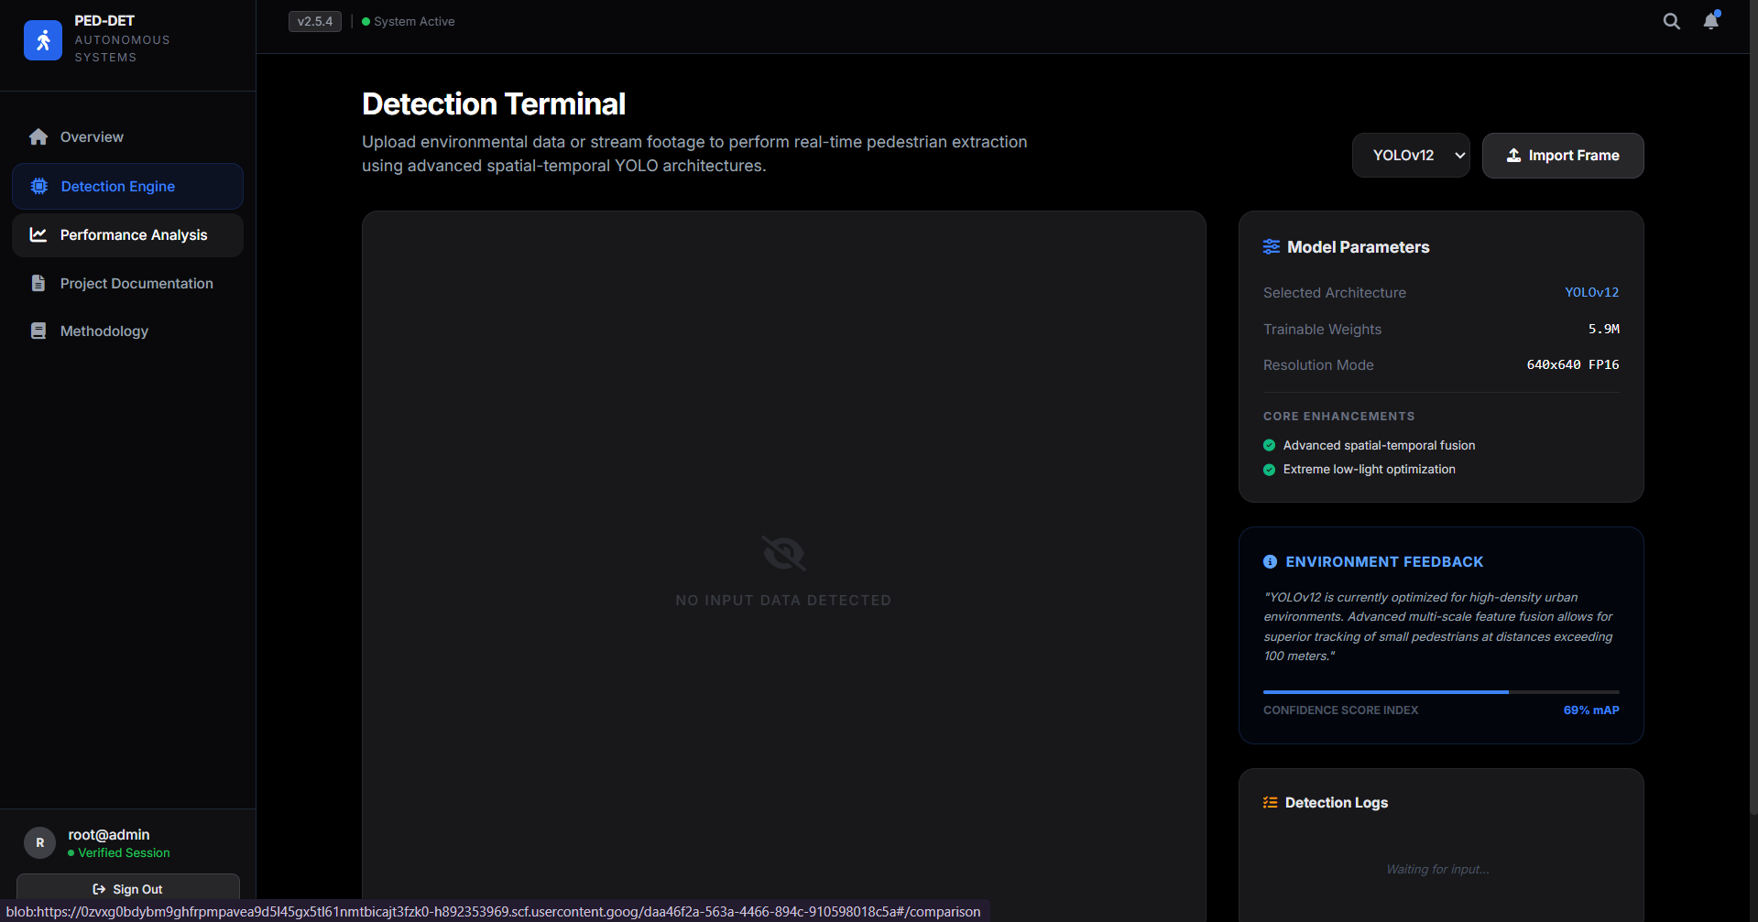
Conti..
Fig: Detection Terminal

Slide 18
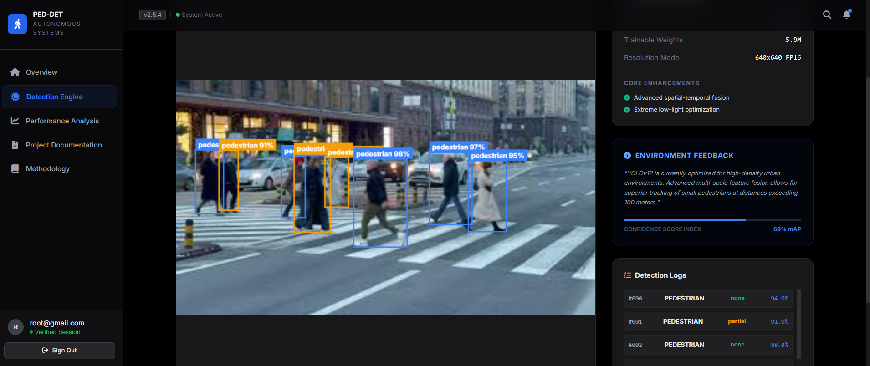
Results & Analysis
Fig: pedestrian detection results

Slide 19
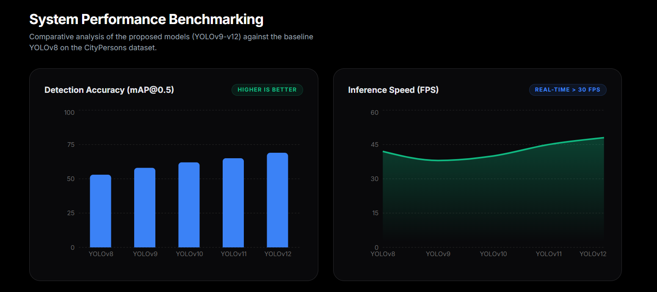
Conti..
Fig: Performance Illustrations

Slide 20
Reference
Sukkar et al. (2024) provide a comprehensive survey of deep learning models like YOLO, SSD, and Faster R-CNN for pedestrian detection, highlighting challenges such as occlusion, scale variation, and dataset limitations.
Masmoudi et al. (2019) compare SVM, YOLO, and SSD for autonomous vehicles, showing that YOLO is fast but struggles with small objects, while SSD handles multi-scale detection better.
Wang et al. (2019) explore one-stage pedestrian detection using ResNet + SSD, emphasizing the benefits of multi-scale feature maps and real-time performance for small and occluded pedestrians.

Slide 21
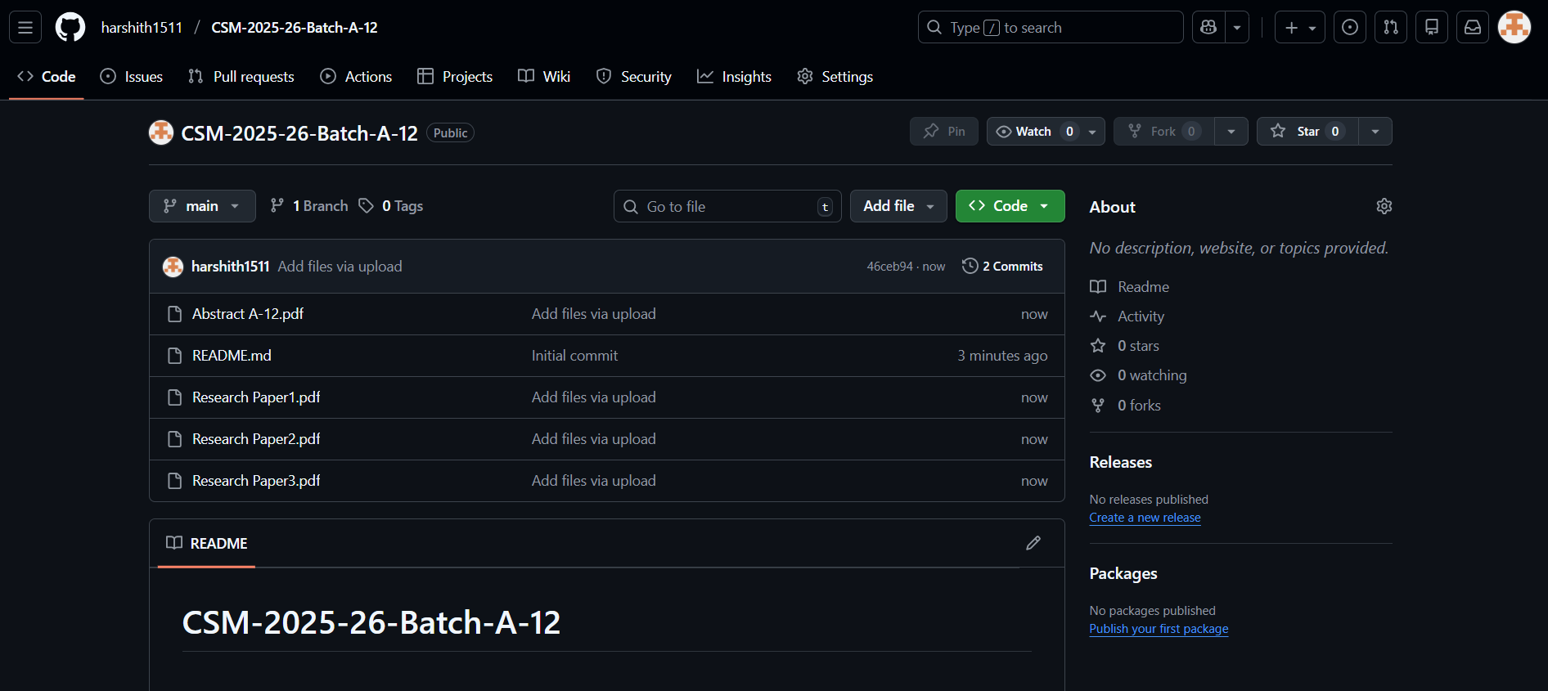
GitHub Link

Slide 22
Any Queries?

Slide 23
Thank You!!!

